Slide 1
Plant Disease Detection
Guided By:
​Sushil Narang Sir
(HOD.AI)

Slide 2
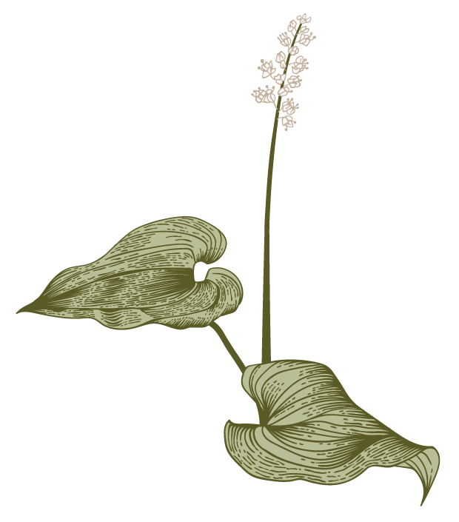
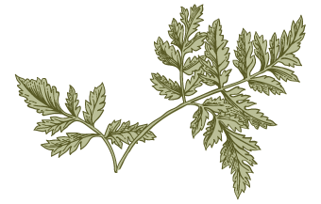
Agenda
Introduction
Objective
Requirements
Dataset
Implementation
Advantages
A

Slide 3
Introduction
Diseases in plants cause major production and economic losses as well as a reduction in both the quality and quantity of agricultural products.
In India, 70% of the population depends on agriculture and contributes 17% towards the GDP of the country.
Now a day’s plant disease detection has received increasing attention in monitoring large fields of crops. Farmers experience great difficulties in switching from one disease control policy to another.
The naked eye observation of experts is the traditional approach in practice for the detection and identification of plant diseases.

Slide 4
Objective of the Automatic Plant Disease Detection
Automatic detection of plant leaf diseases and classification.
Forecasting of plant leaf disease as soon it appears on plant leaves.
Increase accuracies using larger dataset to train the algorithm and maximize epoch statement values.
Making use of the existing deep learning model for plant leaf detection and checking performance on basis of validation.

Slide 5
Simulation Requirements
Minimum Hardware Requirement
Pc with core i3 processor
4GB Ram
32GB hard disk
2GB graphic card
Languages/libraries Required
JavaScript
HTML
CSS
Python
Keras
TensorFlow
Flask

Slide 6
Dataset(Plant Disease Dataset)
This dataset collected from opensource websites (Kaggle.com.in)
This dataset contains 60K+ image samples of 14 crops.
This dataset consist of 38 classes corresponding to 38 leaf disease of 14 crops.
Example:
Apple Scrab 3. Cherry powdery
Grapes Black Rote 4. Tomato Bacterial Spot

Slide 7
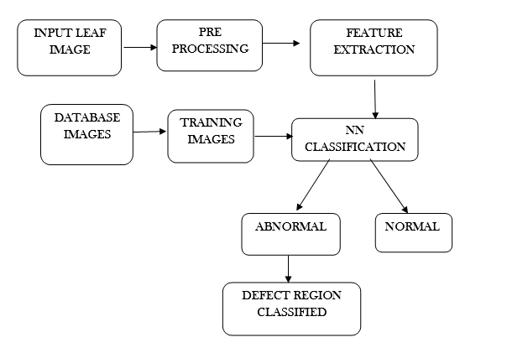
Implementation

Slide 8
Advantages
Bringing a step toward a new technocratic world of Artificial Intelligence . Reducing the problem of food scarcity. And contribution toward the plant and food resources mangement.
As discussed, model is used for the detection of diseases using plant leaf image. Easily accessed by user anytime. Our model is covering accuracy of 94 percent. Increasing production in the field of farming.
Hence, our model is used for the detection of plant diseases. Disease detection involves the steps like image acquisition, image processing, feature extraction and classification of diseases.

Slide 9
Thank You
By:
Sargun Singh 2110993830
Sidakdeep Singh 2110993838
Sohil Dhiman 2110993839

